Slide 1

DRUG MONEY
An Analysis by Kunal Shah
.trbimg.com/img-58c1ff36/turbine/sd-me-military-drugs-20170309

Slide 2

ABOUT ME
New Jersey Institute of Technology, 2013 – 2016
B.A. Biology, Accelerated 7-Year Dentistry Program
Rutgers School of Dental Medicine, 2016 – 2017
Doctor of Dental Medicine (D.M.D.)
Extensive Interning, Shadowing, & Volunteering experience
Dentist Offices, Hospitals, Physician Offices, Clinics, etc.
custompedalboards.co.uk/wp-content/uploads/2014/08/concrete-texture-abstract-hd-wallpaper-1920x1080-5954.jpg

Slide 3
Preface
2013 Study:
9 of 10 largest Pharma companies spent more money on marketing compared to research
Do the Payments Doctors receive from Pharmaceutical Companies affect the type of prescriptions they write?
Datasets via Centers for Medicare & Medicaid Services
Medicare Part D Prescriptions – National provider Identifier (NPI)
Open Payments Database – Payment ID
custompedalboards.co.uk/wp-content/uploads/2014/08/concrete-texture-abstract-hd-wallpaper-1920x1080-5954.jpg

Slide 4
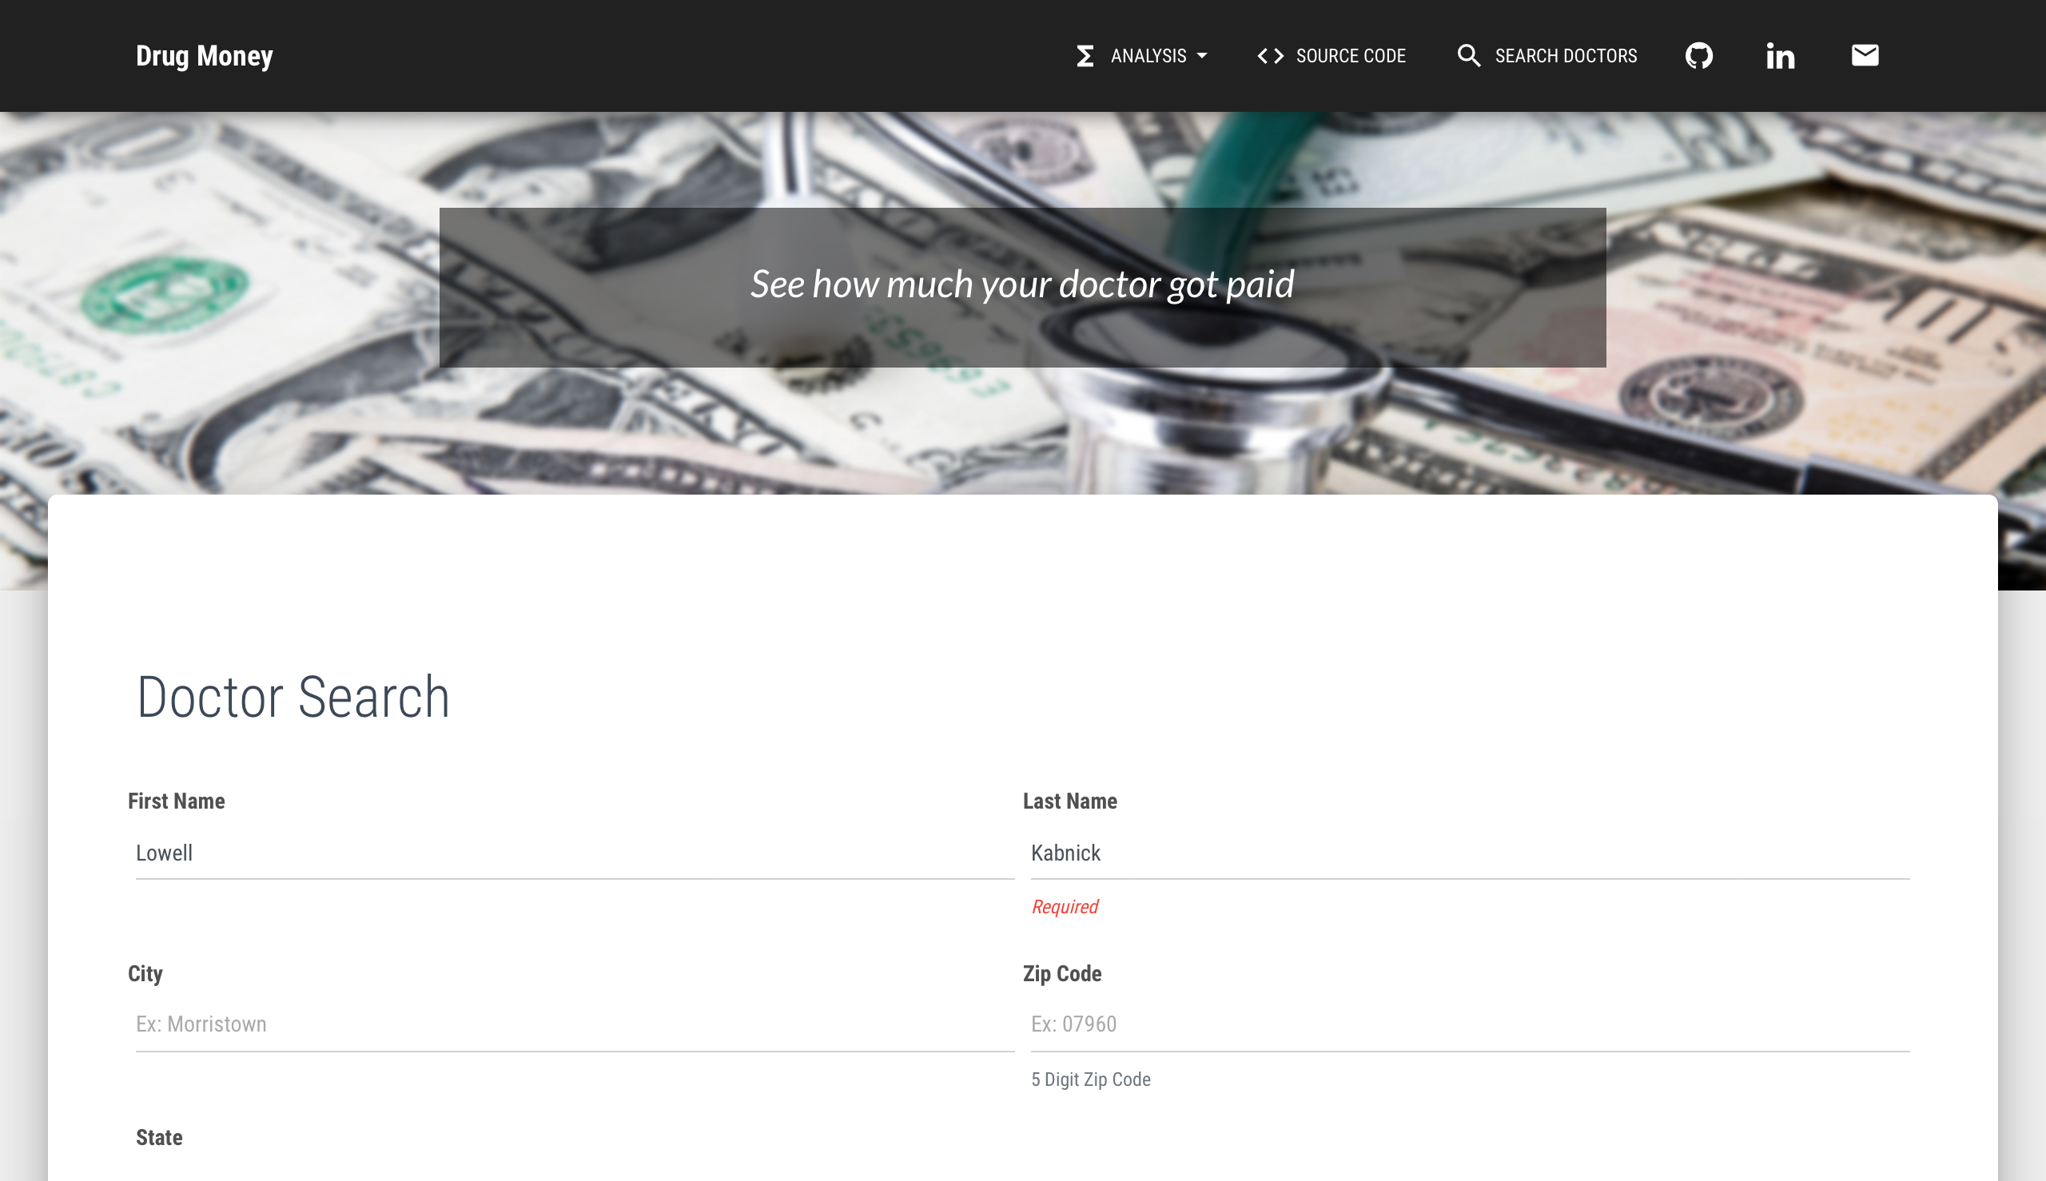
How much was your Doctor paid?
custompedalboards.co.uk/wp-content/uploads/2014/08/concrete-texture-abstract-hd-wallpaper-1920x1080-5954.jpg

Slide 5
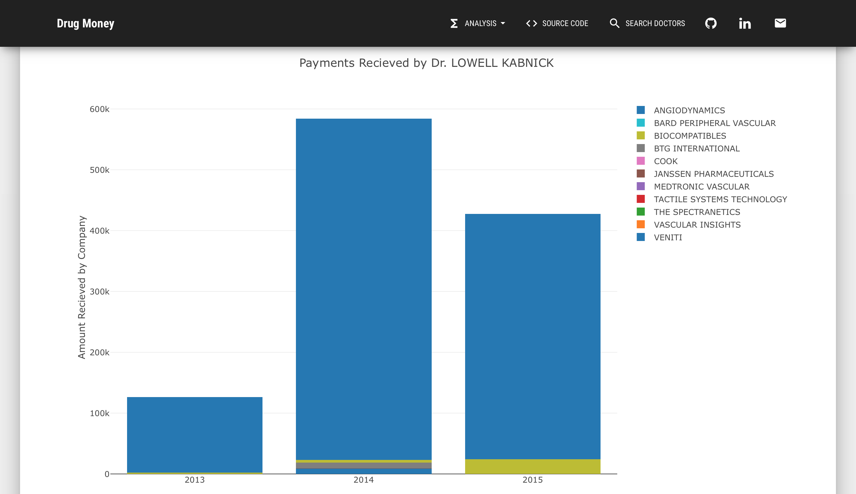
How much was your Doctor paid?
custompedalboards.co.uk/wp-content/uploads/2014/08/concrete-texture-abstract-hd-wallpaper-1920x1080-5954.jpg

